Slide 1
Results from LOCO/CIS
and future plans
Femke de Jong (NIOZ, Duke)
Laura de Steur (NIOZ, NPI)
Johannes Karstensen (GEOMAR)

Slide 2
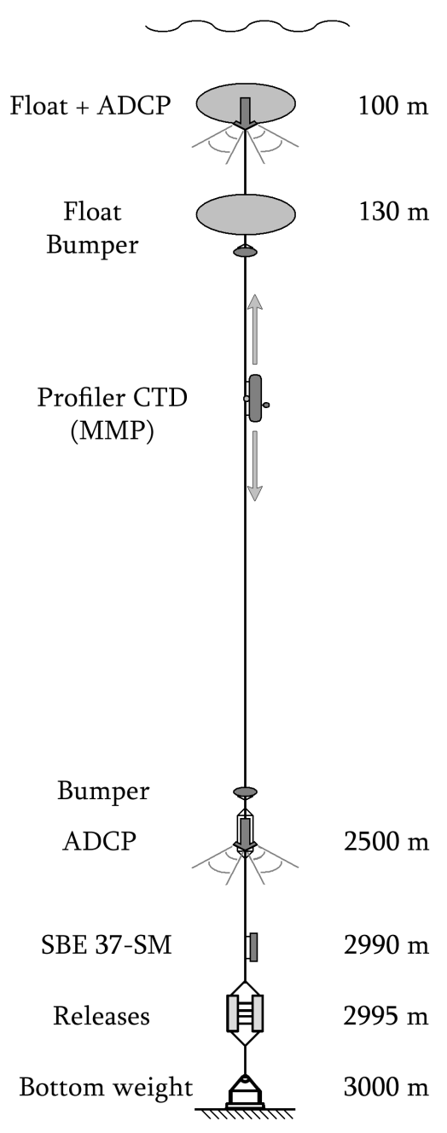
The LOCO mooring
Center of Irminger Gyre, near AR7W section.
Now near OSNAP line.
First deployed in Sept 2003.
Most recent recovery
19 July 2015.
Maintained by NIOZ under NACLIM

Slide 3
Irminger Sea moorings
German Central Irminger Sea (CIS) mooring.
Discrete sensors (12 microcats, 3 current meters).
Biochemical sensors in mixed layer.
Recently joined by OOI
(Ocean Observatories Initiative)
Three moorings
Gliders
Surface buoy
OOI
CIS
LOCO

Slide 4
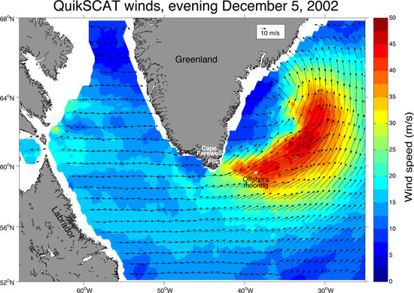
Why the Irminger Sea?
Region of deep water formation.
At the start of the program not much was known.
Weak stratification
Occasional strong
surface forcing
Summer hydrographic
sections were not enough.

Slide 5
What have we learned?
Significant deep convection occurs.
Primarily dependent on sfc heat flux, sec. on stratification.

Slide 6
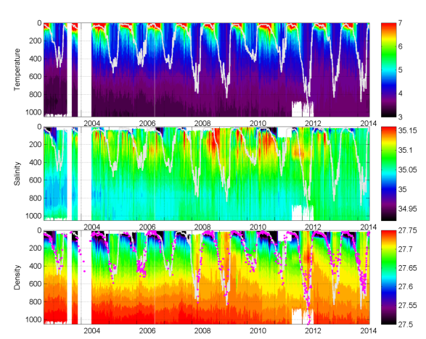
CIS time series
CIS time series of conservative temp, absolute salinity and potential density.
Heating and warming at start, but cooling and freshening after several convective years.
Fig. Johannes Karstensen, GEOMAR

Slide 7
Hydrography July 2015
AR7E/OSNAP east CTD sections shows large volume of recently ventilated water.
Low temperature/salinity.
High O₂.
Density ranges of LSW.
Resembles situation of 1990s.

Slide 8
Relation to SST anomalies
Cold NA subpolar gyre in a warm winter/year.
(warming hole
or cold blob)
Speculations about relation to declining AMOC.

Slide 9
ERSST time series
Interannual and multidecadal variability in ocean
Vs
Continuous heating of Northern Hemisphere.
Recent cold winter(s) dropped Subpolar Gyre below Tref.

Slide 10
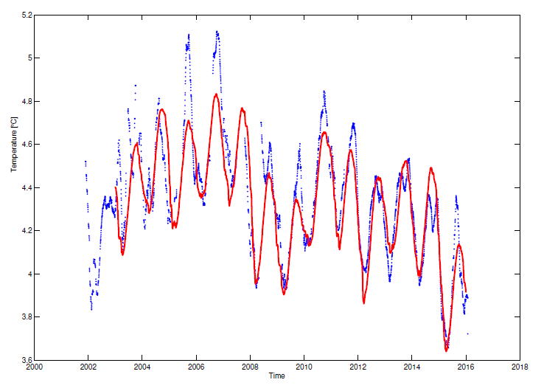
Mostly caused by local sfc forcing
At LOCO the temperature changes can be explained nearly entirely through surface buoyancy forcing.
North Atlantic Regional
Reanalysis (NARR) forcing.
LOCO/Argo 1 km temp.
Cold with respect to NOAA
ref. period, not as cold
as the 1990s
T 0 to 1000m
Apply sfc flux(t) on T(t-1)
+ constant heating
de Jong & de Steur, subm. to GRL.

Slide 11
Future plans
LOCO
Current funding under NACLIM is running out.
Redeployed for a 2-year period in July 2016, unknown after 2018.
CIS
will be redeployed on 2016 and decommissioned in 2018.
OOI
Continue past 2018.
Will provide measurements of convection which may show relation to transport through OSNAP array.

Slide 12
Salinity profiles
Some freshening, but not nearly as fresh (yet) as the 1990s.
Will take successive years of freshwater input and mixing.
practical salinity AR7E

